Slide 1
THE AIRROW

Slide 2



THE PRODUCT
THE AIRROW

Slide 3


Slide 4
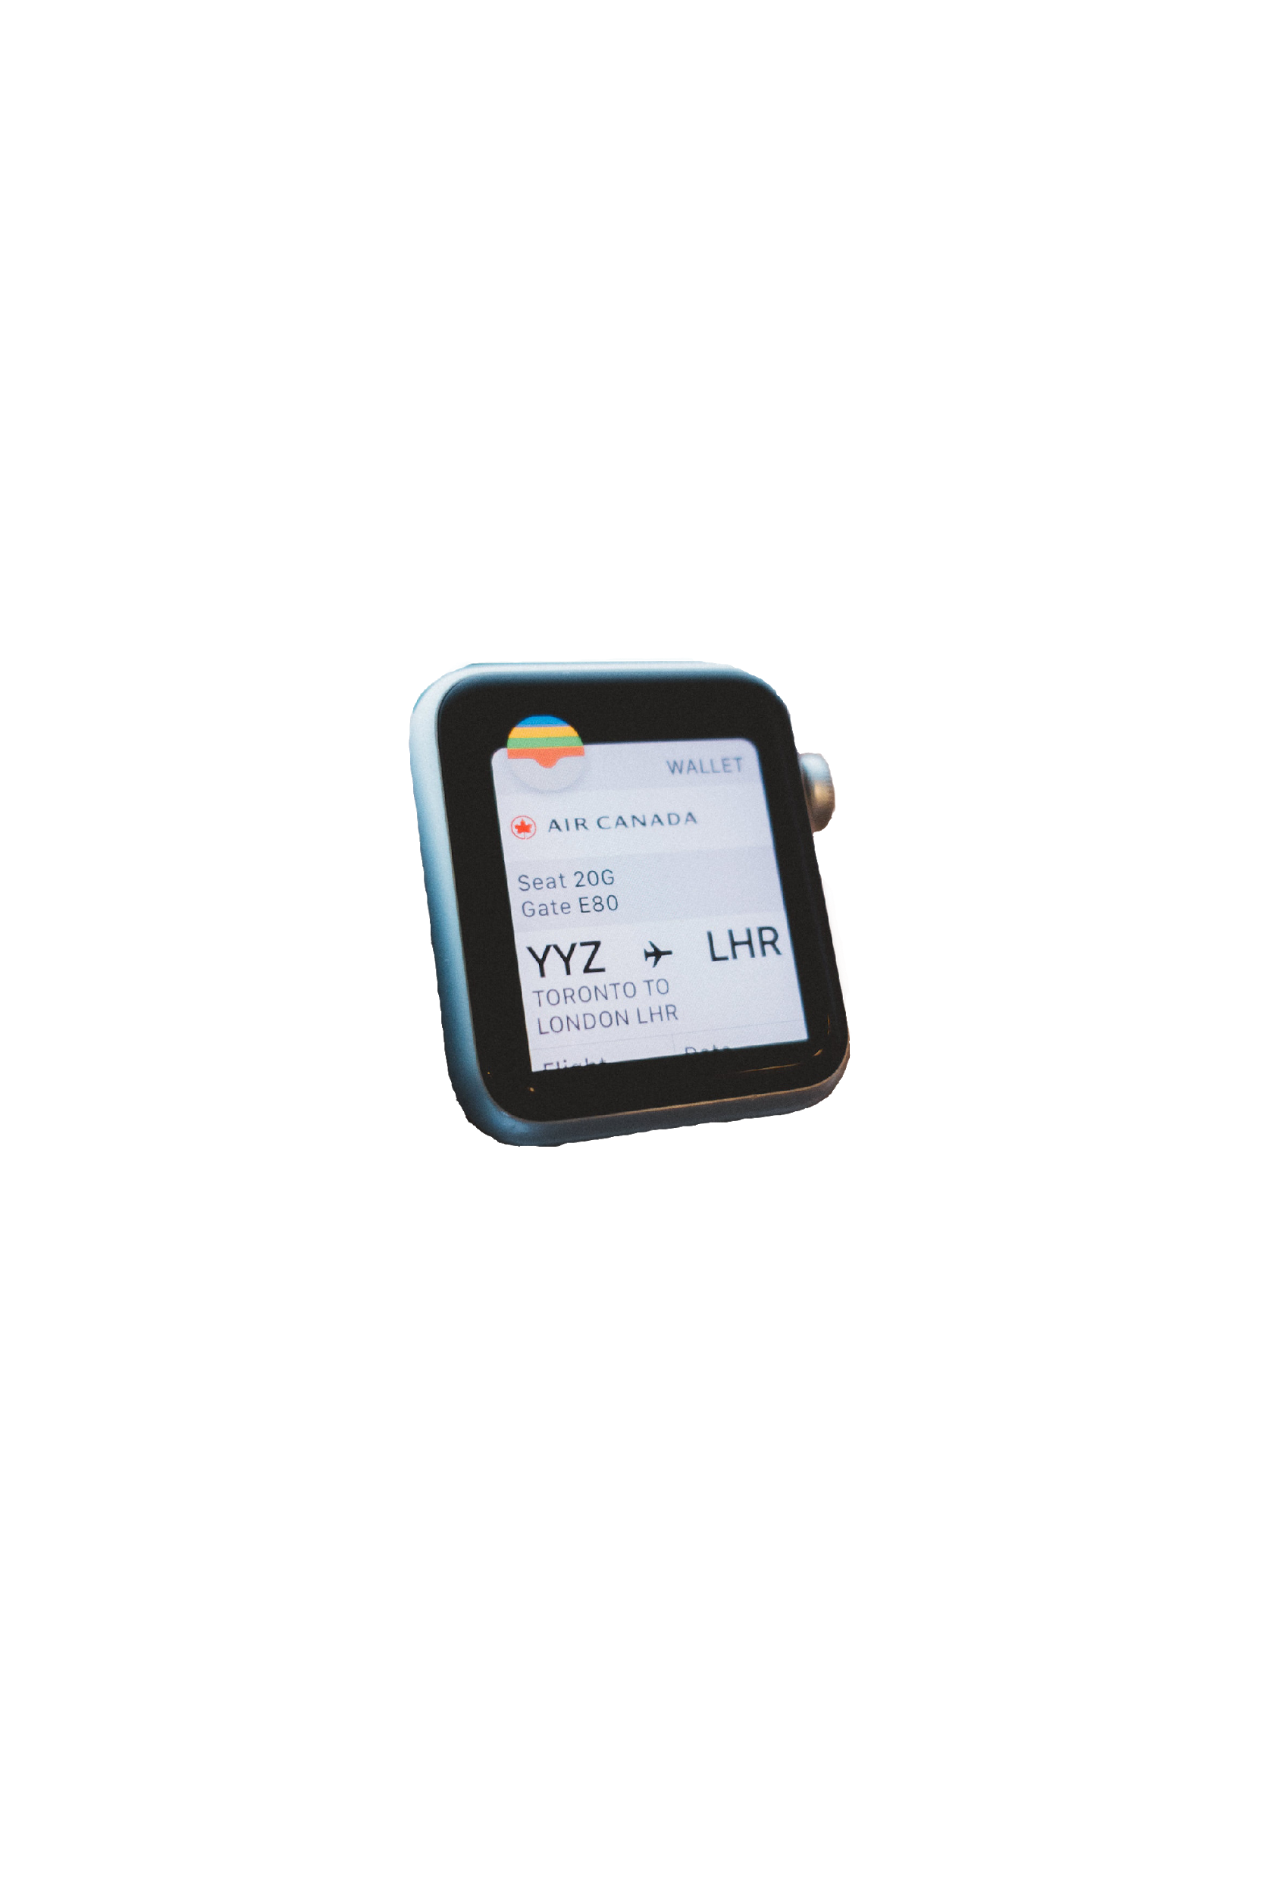

GPS FOR THE AIRPORT

Slide 5

GPS FOR THE AIRPORT
STREAMLINE INFORMATION

Slide 6
YOU ALMOST LATE LMAO.
The Airrow

Slide 7


CENTRALIZATION
THE AIRROW
TARGET MARKET

Slide 8
TARGET MARKET
THE AIRROW

Slide 9


DATA COLLECTION
Know the passengers better
Hot Sports
Marketing and Advertisement

Slide 10



Slide 11
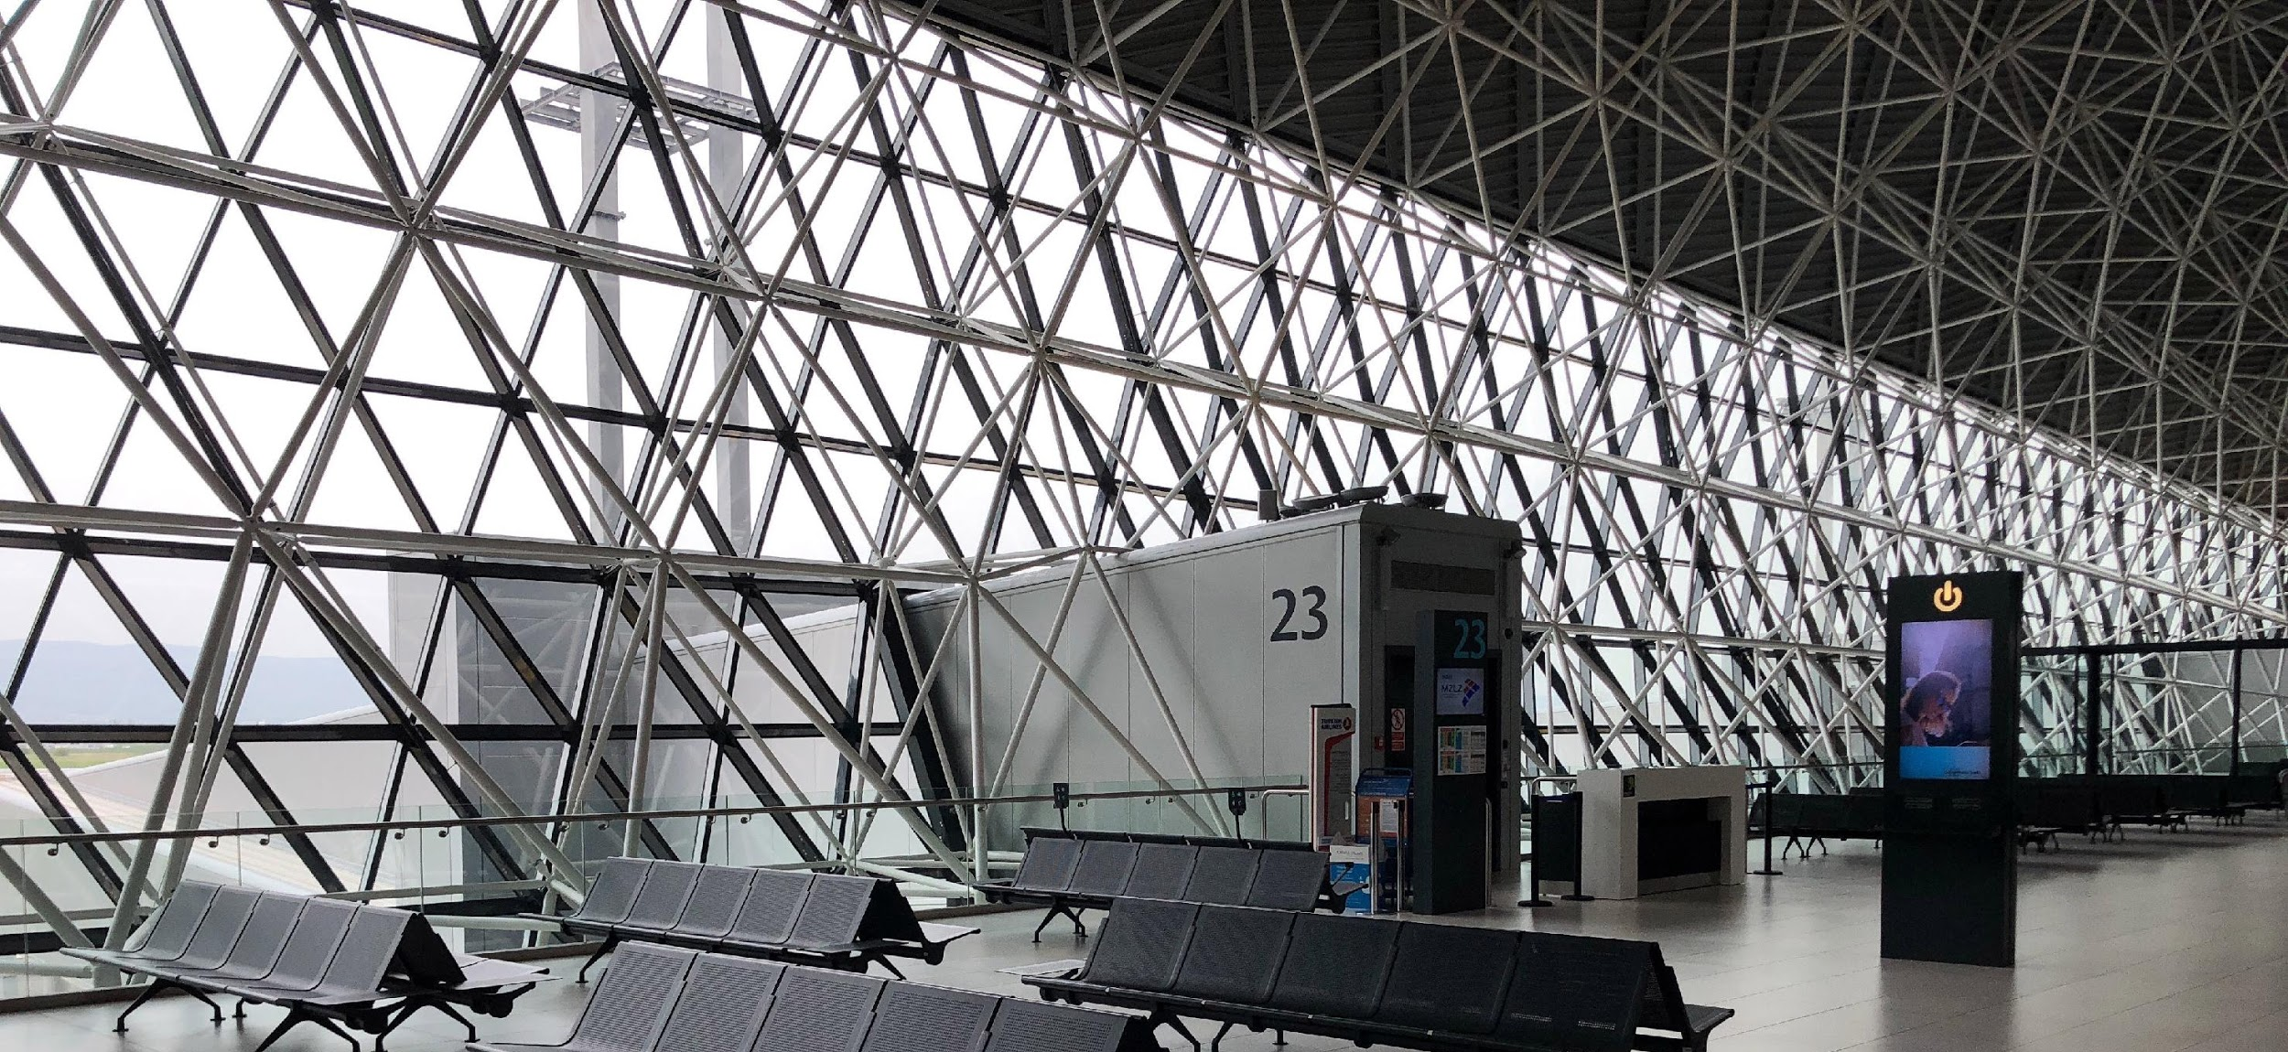
REDUCE COST

Slide 12
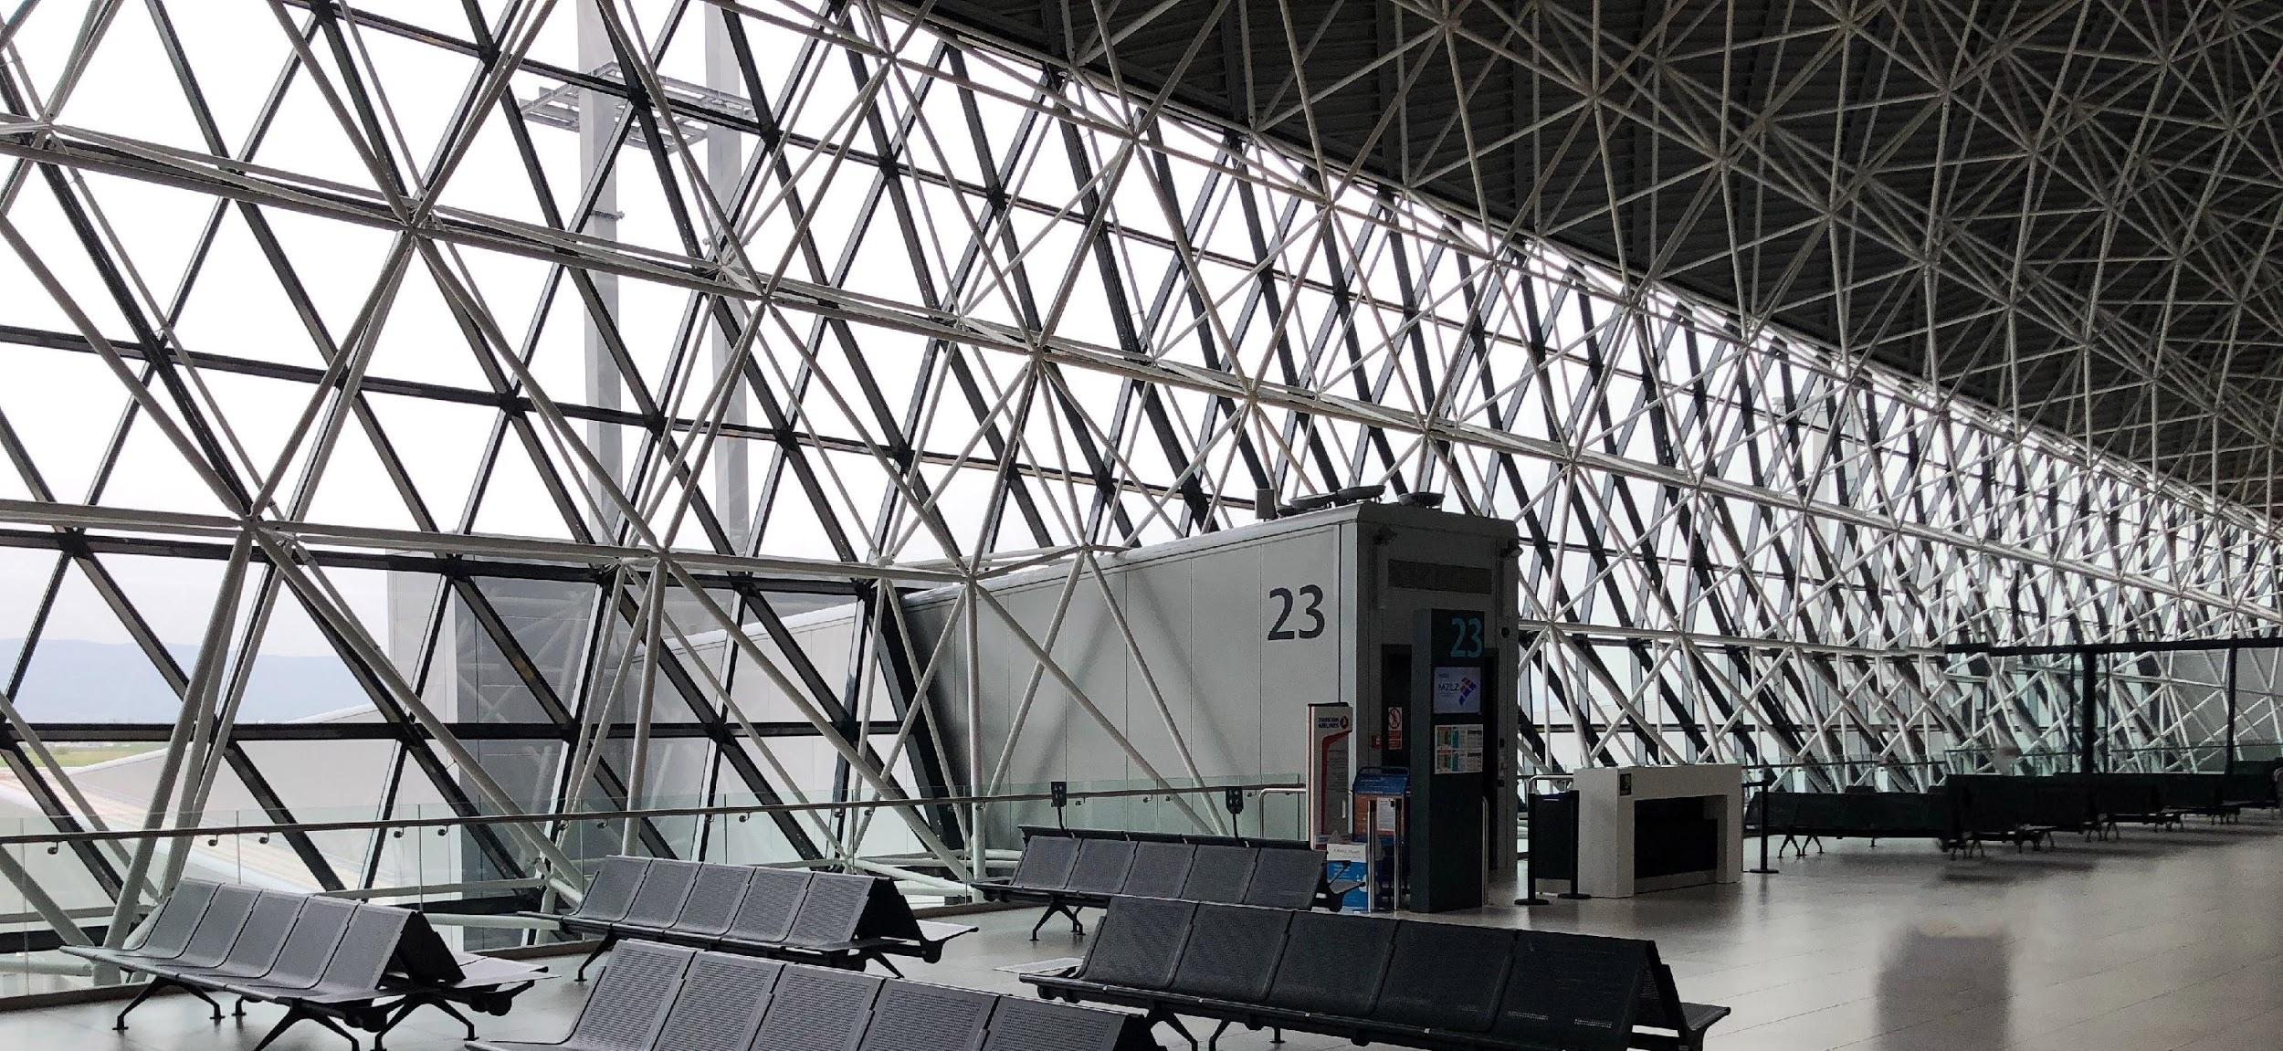
REDUCE COST

Slide 13

REDUCE COST

Slide 14



REDUCE COST
`
TRAVEL EFFICIENCY

Slide 15
TRAVEL EFFICIENCY

Slide 16

PRICING MODEL
App & Hardware
Hardware
App

Slide 17
PRICING MODEL
App & Hardware
Hardware
App

Slide 18
PRICING MODEL
App & Hardware
Hardware
App

Slide 19
PRICING MODEL
App & Hardware
Hardware
App

Slide 20

INDUSTRY FEEDBACK

Slide 21

WEBSITE
https://air-row.github.io/Airrow.github.io/index-4.html

Slide 22

VISION

Slide 23
THE AND

